Slide 1
Agile Engineering Practices
A Module in Agile Fundamentals
Notes:
Welcome to Agile Development Practices, a module in Agile Fundamentals. This module is brought to you by ThoughtWorks Studios, makers of Cruise, Twist, and Mingle.
In this module, we’ll explore the practices that ThoughtWorks considers the essential elements of Agile Development Team practices.

Slide 2
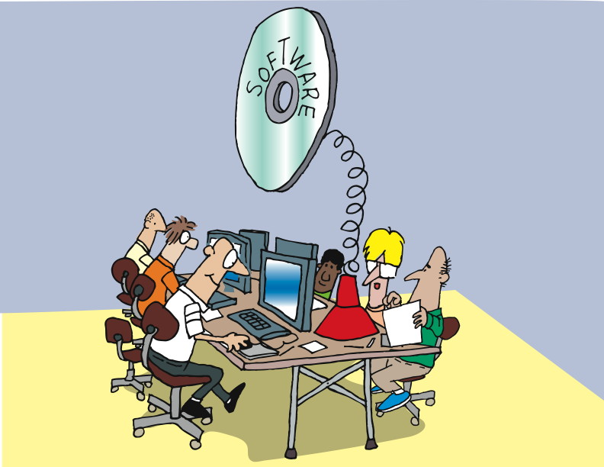
Introduction
Notes:
Software Craftsmanship movement
Requires certain skills and disciplines to do it well
Agile has some best practices as well
--------------------------------------------------------------------------
Some of you may have heard of the Software Craftsmanship movement. Whether you believe that software development is a craft, a profession, an art, or magic, what’s important to think about is that in most cases, software development – like any skilled activity – requires certain disciplines and skills to do it well.
In the Agile world, there are a number of practices that have become best practices, as they are likely to contribute to successfully building, deploying, and maintaining software.
Let’s begin with one of the hardest for most developers to adopt: test-driven development, or TDD.

Slide 3
What We Will Cover
Unit Testing and Test Driven Development
Pairing
Smells
Refactoring
Generalization and Specialization
Continuous Integration

Slide 4
Unit Testing
Notes:
We’ll begin by looking at a little project in the Waterfall way, and see the results of doing it the “traditional” way.
And for those of you who have been through the first two modules, this one is a little bit different…

Slide 5
Unit Test
“A Unit Test is a procedure used to validate that individual units of functional code are working properly. “
Is usually done by developers
Improves quality
Facilitates changes
Simplifies integration
Enables automation
Provides effective system documentation
Makes your life simpler
Notes:
Read the definition.
Is usually done by developers
Improves quality
Facilitates changes
Simplifies integration
Enables automation
Provides effective system documentation.
Makes your life simpler
Assures that you have build the thing right (not necessarily the right thing)

Slide 6
Unit Testing The Agile Way: Test First
Notes:
Now, let’s consider how we’d proceed in an Agile world, considering Test-Driven Development. The key aspect of Test-Driven Development is that the test is created BEFORE the development work is done, hence the name “test first” or “test-driven development”.

Slide 7
Test Driven Development
“Test-Driven Development (TDD) is an evolutionary approach to development which instructs you to have test-first development intent. Basically, you start by writing a test and then you code to elegantly fulfill the test requirements.”
Small successful, tested steps.
Do the simplest thing that could possibly work.
Notes:
Read the slide.
Small successful, tested steps.
Do the simplest thing that could possibly work.

Slide 8
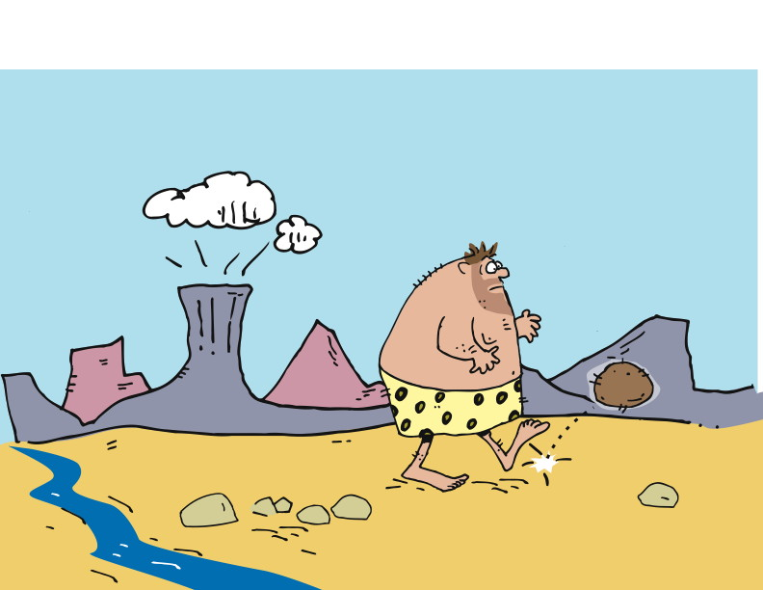
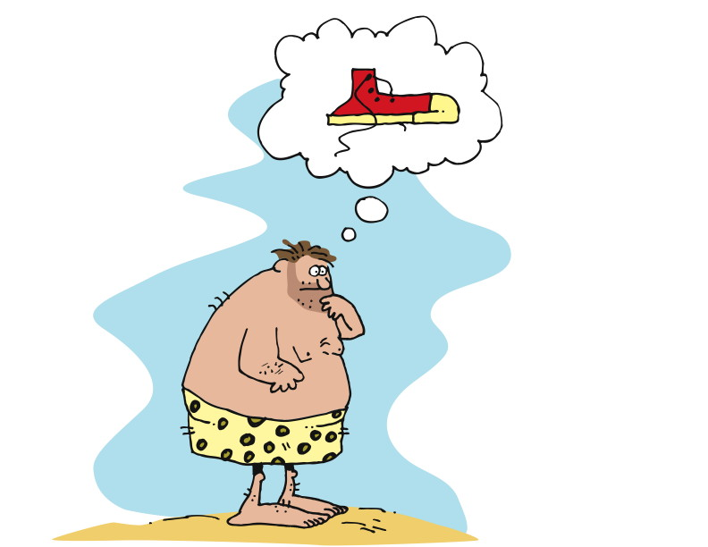
A User Story
Notes:
Hero is walking and stubs his toe.
Has an idea of somehow protecting his feet.
Comes up with a story - “As a walker, I want my feet protected from loose stones, so that I will have fewer bruises on my feet.”
---------------------------------------------------------------------------------------------------------------------
One day, our hero is walking along and stubs his toe on a rock. He identifies a need – he needs to stop stubbing his toes!
The need leads to an idea – the idea of covering his feet somehow, so he won’t stub his toes any more.
In our last module, we talked about user stories a bit. In this case, the story might be something like “As a walker, I want my feet protected from loose stones, so that I will have fewer bruises on my feet.”

Slide 9
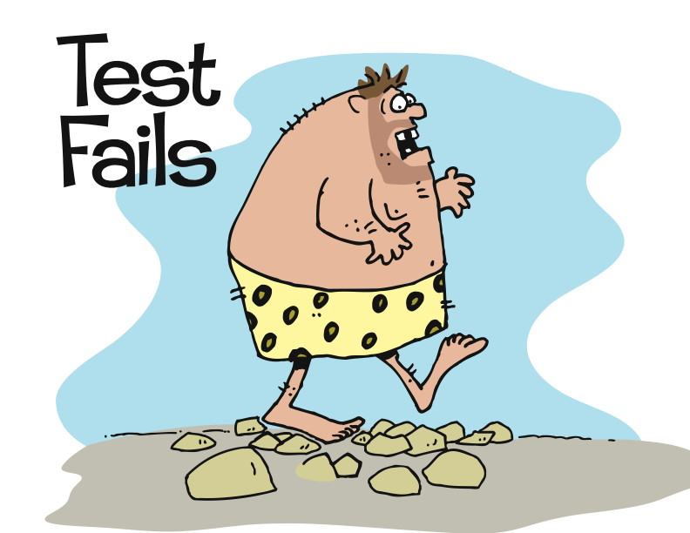
Test First
Notes:
1st the hero writes a test. When I walk on stones, my feet don’t hurt.”
He executes the test.
The test fails.
-----------------------------------------------------------------------------------------------
Unlike in our waterfall version, the first thing our hero does is to write the test.
His test says “When I walk on stones, my feet don’t hurt.”
Then he executes the test.
The results? OW! ☺
So here we have a very specific test that addresses a very specific need, and determines what will be developed.

Slide 10
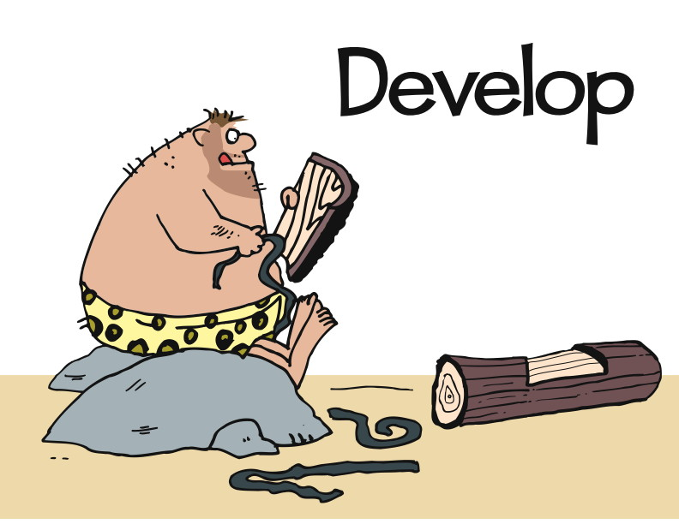
Notes:
Hero develops to get the test to pass.
Most simple design to get the test to pass. Walk on stones without hurting his feet.
Doesn’t address HOW. Just the result.
Develops to the result.
-----------------------------------------------------------------------------------------
During development, our hero has only one goal in mind – to get the test to pass.
That’s it. He wants to make that one, simpler, clear test pass.
So all he needs is something that will allow him to walk on stones without getting his feet hurt.
Notice that the test does not say HOW to pass. It just says what the results must be.
Off he goes, doing development with the intent of getting the test to pass.

Slide 11
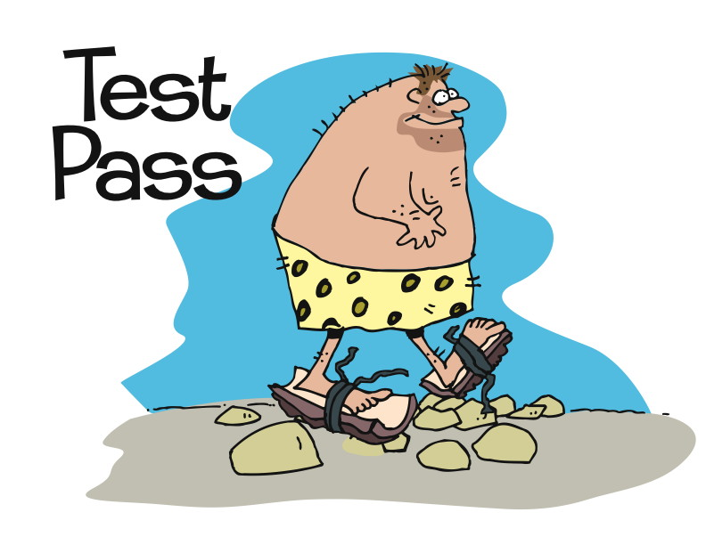
Notes:
Now the test passes.
And the test is part of the build process. Constantly rerunning the test every time a build is run.
----------------------------------------------------------------
And pass it does! Yes, it’s that simple. At least so far.
Determine what it is you are going to create by writing a test, then develop something that passes the test. It shouldn’t do anything more than it needs to to pass that test, however.
And that’s what our hero has here.
Of course, while the test has passed, he looks at what he’s done and realizes that it’s not ideal. It’s not even particularly good. It works, but what if…

Slide 12
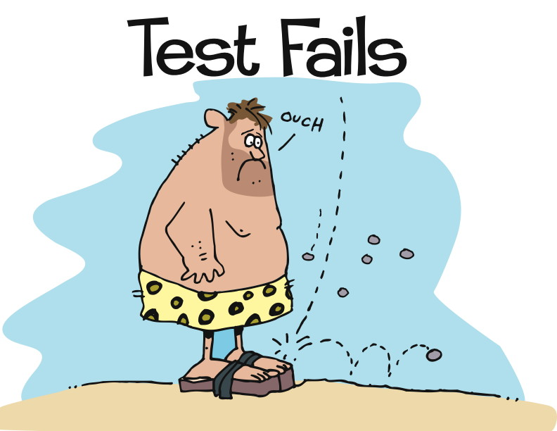
Notes:
A new requirement is received.
Protect my feet from falling objects.
New code is added to accommodate this requirement.
Again, write the test first.
Commit to unit testing by writing the test first
Restrict development to only that to pass the test. And any existing tests.
Know exactly when we are done.
--------------------------------------------------------------------------------------------------------------------------------------------
We do it again. We identify another requirement, which we represent with another test. This will lead us to doing more development, reviewing what we’ve got, and maybe doing some refactoring.
What’s important in all of this, however, is that we start with the test. There are several different points of value in this:
We commit to unit testing everything we do, because we write the test first.
We restrict ourselves to writing only the code we need to satisfy the test, and any existing tests. This keeps our code clean, because we’re not adding stuff that “we might need later.” We don’t consider later, we only consider the now.
Because we start with the test, we know when we’re done – the test has passed! There’s no question about it, since it’s simple and clear.
First, write the test. Then, write the code. When the test passes, you’re done.

Slide 13
Uncle Bob Martin’s Three Laws of TDD
You are not allowed to write any production code unless it is to make a failing unit test pass.
You are not allowed to write any more of a unit test than is sufficient to fail; and compilation failures are failures.
You are not allowed to write any more production code than is sufficient to pass the one failing unit test.
Notes:
What are the benefits of doing TDD?
All code is testable by definition!
In order to test any module in isolation you must decouple it, so TDD forces you to decouple modules.
This forces you to make better designs.
The Law of Diminishing Returns
This is why many actually consider TDD to be a DESIGN practice and not a Development Practice.
“When you follow the three rules of TDD, all your code will be testable by definition! And another word for "testable" is "decoupled". In order to test a module in isolation, you must decouple it. So TDD forces you to decouple modules. Indeed, if you follow the three rules, you will find yourself doing much more decoupling than you may be used to. This forces you to create better, less coupled, designs”
http://butunclebob.com/ArticleS.UncleBob.TheThreeRulesOfTdd

Slide 14
Pairing
Notes:
Let’s start with something fun: Common arguments against pair programming….

Slide 15
Pairing
Why it sucks, and why you should hate it

Slide 16
It’s distracting!
Hard to focus on the problem at hand when your pair is sitting next to you talking

Slide 17
Costly
Two people doing the work of one

Slide 18
Low morale
Only spend 50% of your time doing any actual work

Slide 19
Hygiene
What?! I have to shower every day?!

Slide 20
Stop slowing me down!
Explaining thoughts to my pair will slow me down

Slide 21
Pair Programming
Now let’s talk about the reasons you should do it

Slide 22
Development The Waterfall Way
Notes:
Now that we’ve talked about Test-Driven Development, it’s time to talk about Development. That is, the work you do to pass tests and deliver value.
First, of course, we’ll look at the Waterfall way.

Slide 23
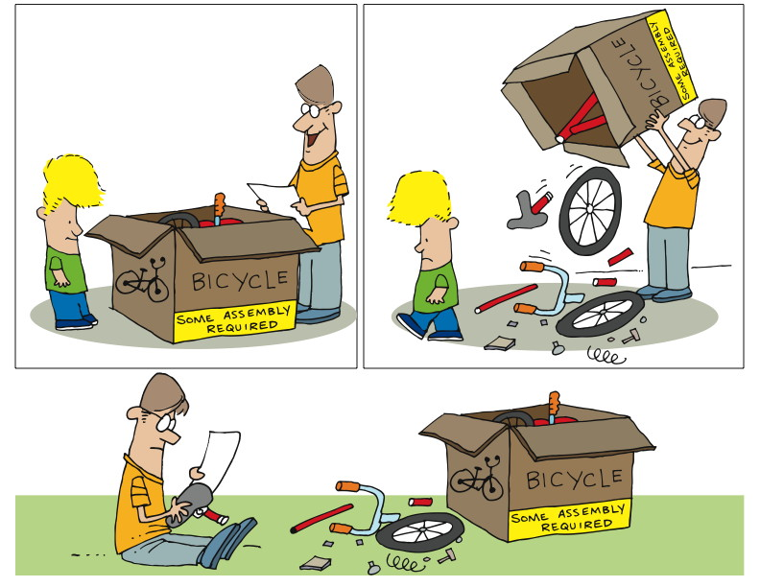
Pairing 1
Notes:
We sit down, confident of our ability.
We read the instructions, follow them carefully.
At some point we realize we’ve put widget A into slot 1 as we were told, but we put it in BACKWARDS.
Take it apart to reverse widget A
Let’s consider the classic approach. For those of you who are parents, or who have ever bought anything that says that dreaded phrase “some assembly required” – this example is for you!
Most of us have had the same kinds of experiences. We sit down, confident of our ability to put the thing together. We read the instructions, and we follow them very, very carefully. And, at some point, we realize that we’ve put widget A into slot B, just as we were supposed to, but we put it in BACKWARDS! And now we have to take the thing apart far enough to reverse widget A. And then we get to put it all together again. Sigh.

Slide 24
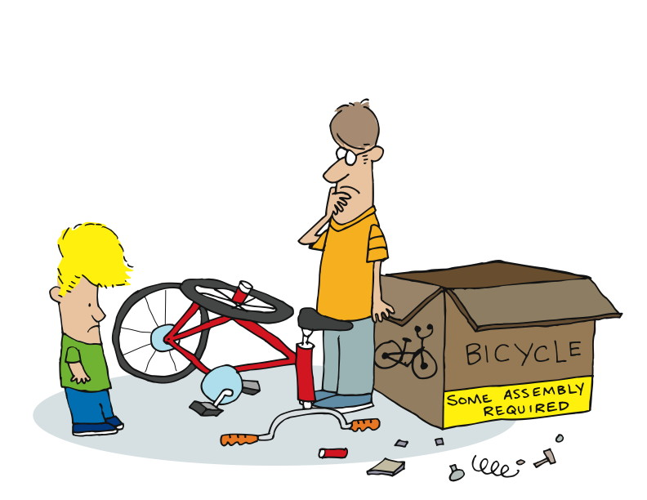
Pairing 2
Notes:
Or we get to the end, but it just doesn’t look right.
How can we avoid this?
-----------------------------------------------------------------------------------------------------------------
Or we get all the way to the end, only to find that we’ve somehow managed to put it all together, but it doesn’t look anything like the picture.
Why does this happen? How can we avoid it?
Maybe…

Slide 25
The Agile Way: Pairing
Notes:
In the module The Origins of Agile Software Development, we talked about Kent Beck and how he came up with Extreme Programming. At that time, we mentioned pairing. Let’s look at pairing in a little more detail now.
Here’s a definition:
“Pair programming is a software development technique in which two programmers work together at one work station. One types in code while the other reviews each line of code as it's typed in. The person typing is called the driver. The person reviewing the code is called the observer or navigator. The two programmers switch roles periodically.
“While reviewing, the observer also considers the strategic direction of the work, coming up with ideas for improvements and likely future problems to address. This frees the driver to focus all of his or her attention on the "tactical" aspects of completing the current task, using the observer as a safety net and guide.”
http://en.wikipedia.org/wiki/Pair_programming
Two of everything is better than one – minds, (pairs of) hands, (pairs of) eyes.
Let’s see why…

Slide 26
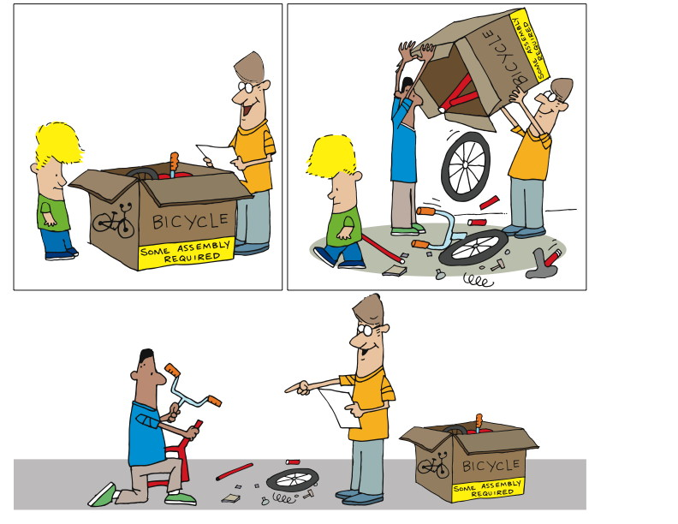
Pairing 3
Notes:
We believe that having 2 people working together produces better results.
Better means…
Fewer defects
Less rework
More creativity
Easier to maintain
Sitting side by side
Working on one piece of code
One is the driver – hands on the keyboard and mouse
Two is navigating, doing code review, asking questions, maybe doing research
Change roles periodically
Instead of being distracting, it turns out to be helpful, useful
-----------------------------------------------------------------------------------------------
Unlike in our classical approach, in Agile we believe that having two people working together produces better results. That is, by “better” we mean that there will be fewer defects, less rework, more creativity, and the results will be easier to maintain.
So in actual practice, pairing would say that there are two people sitting side by side, working on one piece of code together. One – as it said in the definition – is the driver, with hands on keyboard and mouse. The other will be navigating – doing real-time code review, asking questions, maybe doing a little research on the side. They will be bouncing ideas off each other. They will change roles periodically.

Slide 27
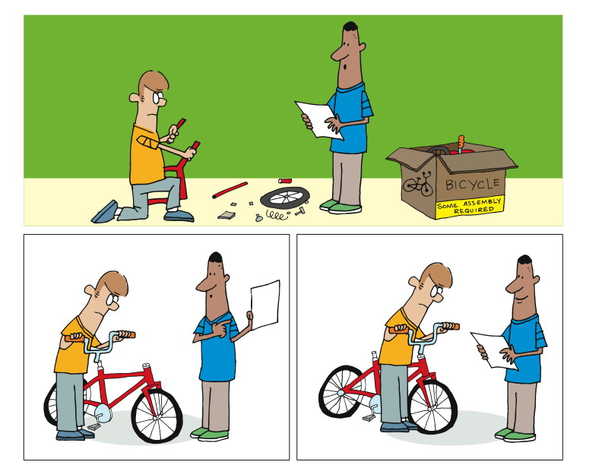
Pairing 4
Notes:
By switching roles,
they stay fresh,
check each other’s work and
get done faster
Instead of low morale, you get collaboration, quality and camaraderie
Let’s talk about quality
2 heads are better than 1 – solution is likely to be better
Will see the problem AS IT HAPPENS. If they are paying attention.
--------------------------------------------------------------------------------------------------------------------------
The driver becomes the navigator and the navigator becomes the driver. Between the two of them, they manage to stay reasonably fresh, to check each other’s work, and to get done faster.
Yes, faster.
But let’s get back to fewer defects. We’re all familiar with the adage “two heads are better than one.” This means that having two people thinking about the same problem is likely to produce a better solution than one working alone.
After all, if one of us is looking at the directions, and the other is putting the thing together, the odds are in our favor that the one looking at the directions and the pictures will notice that widget A is in slot B the wrong way AS IT HAPPENS.

Slide 28
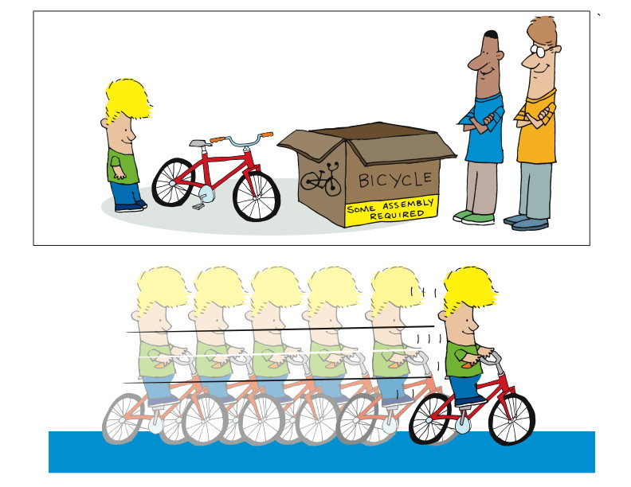
Pairing 5
Notes:
Now let’s get back to faster.
2 people doing the work of one?
Cost me 2x as much?
No to both.
Let’s take a bigger, longer view of the challenge.
-----------------------------------------------------------------------------------------------------------------------
We hear repeatedly “but doesn’t that mean that I have two people doing the work of one? Doesn’t’ that mean that it will cost me twice as much, or take twice as long, to get the same thing done?”
There are two answers to that, and both of them are “no”.
In order to understand the answer, you have to take a bigger and longer view of the challenge.

Slide 29
Studies
Cockburn, Alistair; Williams, Laurie (2000). "The Costs and Benefits of Pair Programming"
Lui, Kim Man; Keith C. C. Chan (September 2006). "Pair programming productivity: Novice-novice vs. expert-expert"
Arisholm, Erik; Hans Gallis, Tore Dybå, Dag I.K. Sjøberg (February 2007). "Evaluating Pair Programming with Respect to System Complexity and Programmer Expertise
Lui, Kim Man; Keith C. C. Chan, John Teofil Nosek (March/April 2008). "The Effect of Pairs in Program Design Tasks"
Hannay, Jo E.; Tore Dybå, Erik Arisholm, Dag I.K. Sjøberg (July 2009). "The Effectiveness of Pair Programming: A Meta-Analysis"
Notes:
These studies show a couple of key things:
Pair programmers are only 15% slower than two independent
Improved correctedness
Novice to experience
Complexity of task.
Public demo - http://blogs.agilefaqs.com/2010/06/13/pair-programming-public-demo/
Blog by Fred George - http://processpeoplepods.blogspot.com/search/label/Pair%20Programming
Based on a survey
100% agreed that they had more confidence in their solution than when they program alone
96% agreed that they enjoy their job more than when programming alone
Laurie Williams of the University of Utah in Salt Lake City has shown that paired programmers are only 15% slower than two independent individual programmers, but produce 15% fewer bugs
The Williams et al. 2000 study showed an improvement in correctness of around 15% and 20 to 40% decrease in time, but between a 15 and 60% increase in effort.
Williams et al. 2000 also cites an earlier study (Nosek 1998) which also had a 40% decrease in time for a 60% increase in effort.
A study (Lui 2006) presents a rigorous scientific experiment in which novice–novice pairs against novice solos experience significantly greater productivity gains than expert–expert pairs against expert solos.[
A larger recent study (Arisholm et al. 2007) had 48% increase in correctness for complex systems, but no significant difference in time, whilst simple systems had 20% decrease in time, but no significant difference in correctness. Overall there was no general reduction in time or increase in correctness, but an overall 84% increase in effort.^{[8][16]}
Lui, Chan, and Nosek (2008) shows that pair programming outperforms for design tasks.^{[17]}
A full-scale meta-analysis of pair programming experimental studies, from before or during 2007, (Hannay et al. 2009) confirms "that you cannot expect faster and better and cheaper". Higher quality for complex tasks costs higher effort, reduced duration for simpler tasks comes with noticeably lower quality - the meta-analysis "suggests that pair programming is not uniformly beneficial or effective".^{[18]}

Slide 30
Studies of Pair Programming
Pair programmers are only 15% slower than two individuals but produces 15% fewer defects
100% agreed that they had more confidence in their solution than when they program alone
96% agreed that they enjoy their job more than when programming alone
Notes:
Improved correctedness
Novice to experience
Complexity of task.
Public demo - http://blogs.agilefaqs.com/2010/06/13/pair-programming-public-demo/
Blog by Fred George - http://processpeoplepods.blogspot.com/search/label/Pair%20Programming
Based on a survey
100% agreed that they had more confidence in their solution than when they program alone
96% agreed that they enjoy their job more than when programming alone
Laurie Williams of the University of Utah in Salt Lake City has shown that paired programmers are only 15% slower than two independent individual programmers, but produce 15% fewer bugs
The Williams et al. 2000 study showed an improvement in correctness of around 15% and 20 to 40% decrease in time, but between a 15 and 60% increase in effort.
Williams et al. 2000 also cites an earlier study (Nosek 1998) which also had a 40% decrease in time for a 60% increase in effort.
A study (Lui 2006) presents a rigorous scientific experiment in which novice–novice pairs against novice solos experience significantly greater productivity gains than expert–expert pairs against expert solos.[
A larger recent study (Arisholm et al. 2007) had 48% increase in correctness for complex systems, but no significant difference in time, whilst simple systems had 20% decrease in time, but no significant difference in correctness. Overall there was no general reduction in time or increase in correctness, but an overall 84% increase in effort.^{[8][16]}
Lui, Chan, and Nosek (2008) shows that pair programming outperforms for design tasks.^{[17]}
A full-scale meta-analysis of pair programming experimental studies, from before or during 2007, (Hannay et al. 2009) confirms "that you cannot expect faster and better and cheaper". Higher quality for complex tasks costs higher effort, reduced duration for simpler tasks comes with noticeably lower quality - the meta-analysis "suggests that pair programming is not uniformly beneficial or effective".^{[18]}

Slide 31
Pairing
Find someone to pair with
You are going to write a story
One writes, one makes sure rules are followed
Swap, and do it again
Notes:
Prioritize stories into Minimum Marketable Features (MMF)

Slide 32
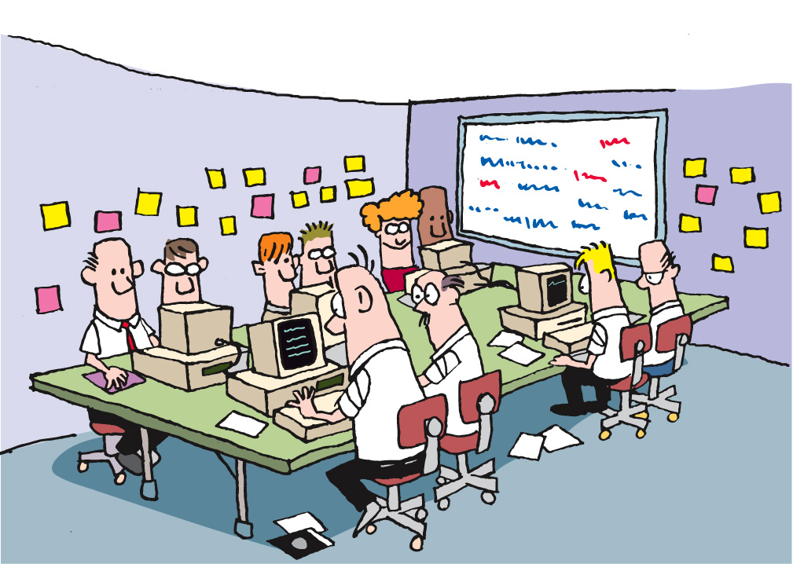
Team Smells
Notes:
Team smells
Someone with headphones
May not be a smell, but worth investigating
Same pair all the time
Regular issues with one BA’s stories
-----------------------------------------------------------------------------------------
Let’s also consider a different form of smell – team smells. Imagine that you have a collocated team. As you walk into the team room, you notice that one member of the team has headphones on and is bopping along to some music that only they can hear. Everyone seems happy, most of the team is pairing, work is getting done, and yet…
That team member with the headphones on is a team smell. Why? One of the keys to success on an agile team is ongoing communication and osmotic learning. Osmotic learning is the learning that takes place when conversations and discussions are going on, and I learn just by overhearing. And, of course, I may hear something that stimulates me to jump in and contribute. The team dynamics on Agile teams are exciting, because there’s so much communication going on.
So if you have a team member with headphones on, they’re disconnected from the rest of the team, isolated from any osmotic learning, and not contributing to the life of the team.
It’s not NECESSARILY a bad thing. But as with any smell, it’s worth investigating.

Slide 33
Refactoring

Slide 34
What is Refactoring?
A series of small steps, each of which changes the program’s internal structure without changing its external behavior
Notes:
A series of small steps, each of which changes the program’s internal structure without changing its external behavior
Verify no change in external behavior by
Testing
Being very, very careful

Slide 35
The Need for Refactoring

Slide 36
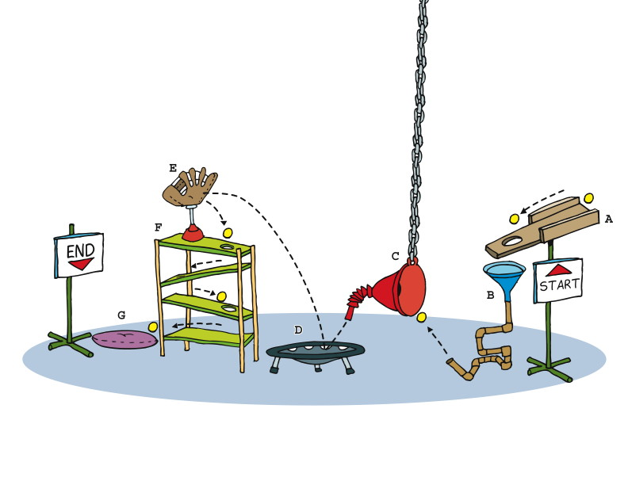
Refactoring 3
Notes:
Refactoring is about making it cleaner, more understandable, more maintainable.
Classically, software grows and grows, accreting more layers and complication and cruft as time goes on. This is sometimes referred to as topsy-ware, from the character Topsy, A "ragamuffin" young slave girl in the novel “Uncle Tom’s Cabin”. When asked if she knows who made her, she professes ignorance of both God and a mother, saying "I s'pect I growed. Don't think nobody never made me.”
Too much software just growed.
In nautical terms, the accretion might be thought of as barnacles, and refactoring as the process of scraping off the barnacles so that the boat can flow smoothly through the water.
Consider the process in front of you. What is its purpose? It seems to be intended to get the ball from the Start at point A to the End at poing G, right? Simple.

Slide 37
Why Refactor
To make room for new functionality
To make the program easier to change
To make the software easier to understand
To “Fix broken windows”
Notes:
To make room for new functionality
Getting ready for structural change
To make the program easier to change
Remove duplication
Put behavior in the right place
To make the software easier to understand
Express intent
Understand unfamiliar code
To “Fix broken windows”
The Pragmatic Programmers
A broken window.
One broken window, left unrepaired for any substantial length of time, instills in the inhabitants of the building a sense of abandonment—a sense that the powers that be don’t care about the building. So another window gets broken. People start littering. Graffiti appears. Serious structural damage begins. In a relatively short space of time, the building becomes damaged beyond the owner’s desire to fix it, and the sense of abandonment becomes reality.

Slide 38
When to/not to Refactor
Refactor when…..
Adding functionality
Fixing a bug
Pairing
Consider not refactoring when….
Code is too messy (better to start over)

Slide 39
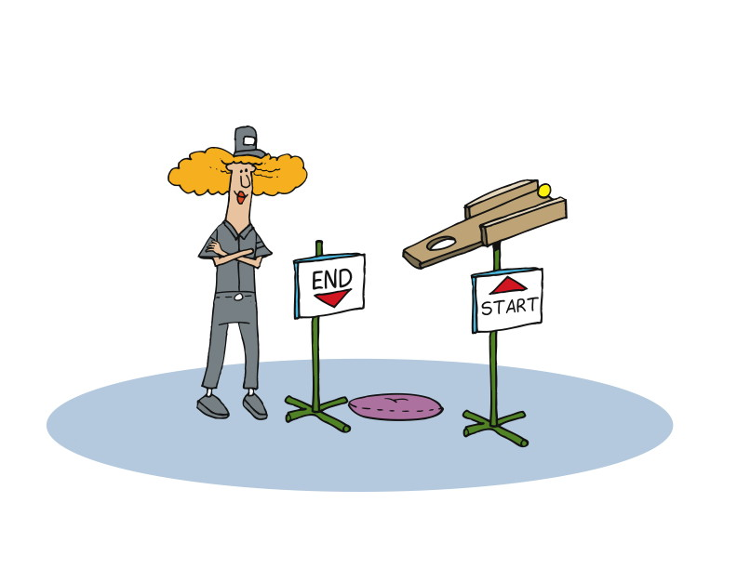
What about ownership?
Notes:
Agile teams avoid personal code ownership and encourage team ownership.
Not my code
Not your code
Part of a product we are building as a team
Each has a responsibility
To produce code easy for others to figure out and work on
We do focus on personal commitment
-------------------------------------------------------------------------------------------------
That last point deserves a little extra attention.
On Agile teams, we avoid personal ownership and encourage team ownership. That means that the code I write is not my code. It’s just code that I wrote as part of our team effort to produce something. And it means that the code you wrote is not your code, but code that is part of the product we’re building that we all own.
Each of us commits to trying to produce code that is easy for others to figure out and work on.
So while we avoid personal ownership and focus on team ownership, we also focus on personal commitment as well as team commitment.
To paraphrase Mr. Spock of Star Trek fame, The Ownership of the Many Must Outweigh the Ownership of the Few or the One, but the commitment of the one is necessary for the commitment of the many.

Slide 40
Refactoring versus Redesign
Refactoring - key part of modern software development practice –don’t need permission
Redesign - Large scale refactoring/redesign decisions should be owned by the whole team
Notes:
You should not need permission to refactor
it is a key part of modern software development practice
you don't need to tell your manager
Large scale refactoring/redesign decisions should be owned by the whole team
redesign requires courage
discuss with the entire team
the team needs to have a shared ownership and a common understanding of what needs to be done

Slide 41
Team practices
Encourage refactoring culture
Provide sound testing base
Shared Code Ownership
Notes:
Encourage refactoring culture
Nobody gets things right first time
Refactoring is forward progress
Provide sound testing base
Tests are essential for refactoring
Build system and run tests continually
Shared Code Ownership
You should be free to refactor any part of the system

Slide 42
Continuous Integration
Notes:
An approach that has been adopted successfully on Agile teams, and is making its way onto teams of all kinds, is Continuous Integration. This is a term that was originally described in a blog post by [CLICK] Martin Fowler in September of 2000.
“Continuous Integration is a software development practice where members of a team integrate their work frequently, usually each person integrates at least daily - leading to multiple integrations per day. Each integration is verified by an automated build (including test) to detect integration errors as quickly as possible. Many teams find that this approach leads to significantly reduced integration problems and allows a team to develop cohesive software more rapidly.”
http://www.martinfowler.com/articles/continuousIntegration.html

Slide 43
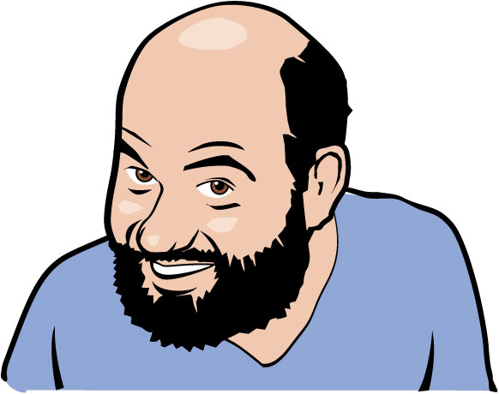
“Continuous Integration is a software development practice where members of a team integrate their work frequently, usually each person integrates at least daily - leading to multiple integrations per day. Each integration is verified by an automated build (including test) to detect integration errors as quickly as possible. Many teams find that this approach leads to significantly reduced integration problems and allows a team to develop cohesive software more rapidly.”
http://www.martinfowler.com/articles/continuousIntegration.html
Notes:
Read the slide.

Slide 44
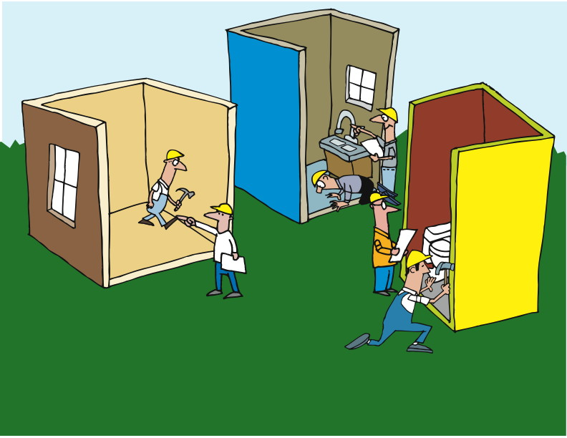

www.thoughtworks-studios.com
Copyright 2010 ThoughtWorks
Notes:
Each project or subsystem working in isolation from the others.
Some communication, but not enough.
Limited to integration specific discussions.
Tested loosely until the parts are integrated as a whole.

Slide 45
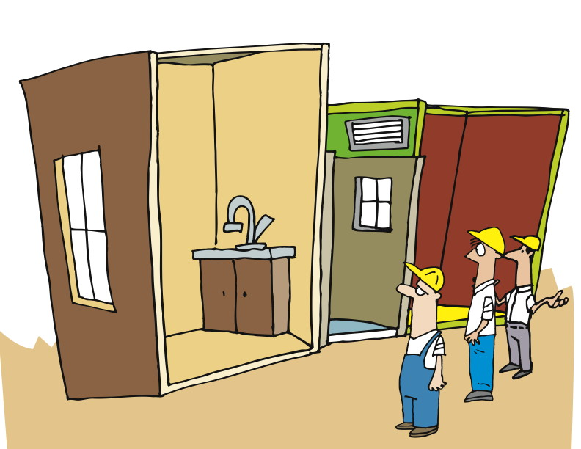
www.thoughtworks-studios.com
Copyright 2010 ThoughtWorks
Notes:
Of course, there are problems with this. They can be as simple as getting the data type wrong for an argument, and as complex as transformations that are applied to data within one subsystem that make it incompatible with another.
The biggest problem, of course, is that the teams do ALL the work before ever trying to bring things together.

Slide 46
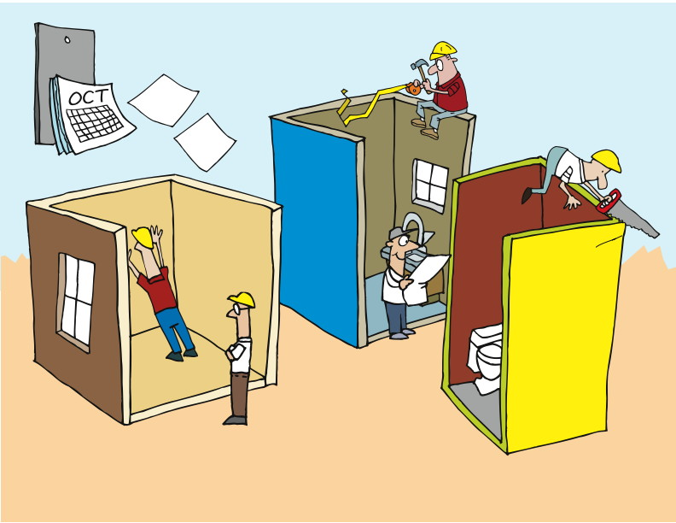
www.thoughtworks-studios.com
Copyright 2010 ThoughtWorks
Notes:
Which means that we have the same problem we had when we talked about pairing and catching defects early: rework.
When you’ve built the whole thing, and then have to go back and figure out where the problems are and who should fix which and how, well, it just gets complicated and costly and time-consuming.

Slide 47
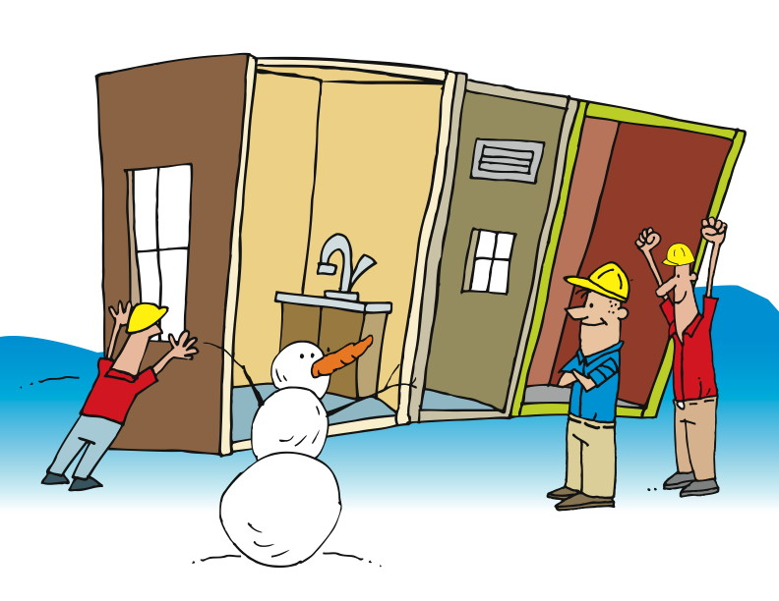
Eventually…
www.thoughtworks-studios.com
Copyright 2010 ThoughtWorks
Notes:
Ultimately, the team may meet with success. But along the way, the pain is shared by everyone.

Slide 48
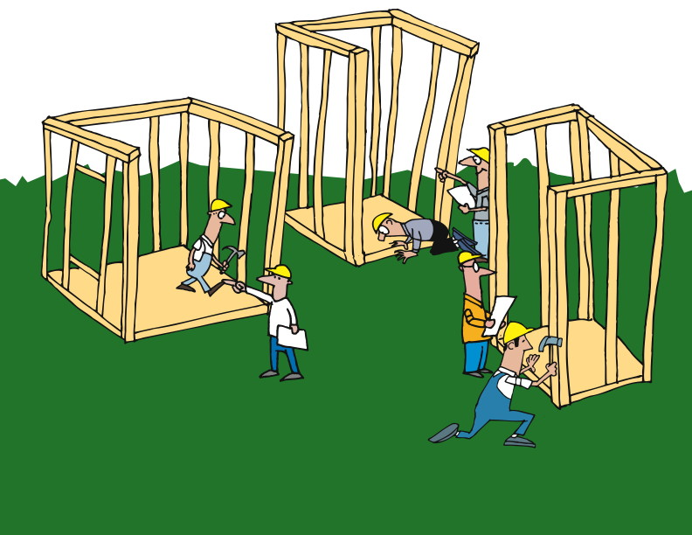
Independent Action
Notes:
We’ve got separate teams working on separate parts
We may be able to rotate personnel, but maybe not
------------------------------------------------------------------------------------------------------------------
Let’s consider the same scenario we discussed a minute ago.
We have separate teams, each of which is working on a piece – a class, a subsystem, a system, whatever it is – that is intended to connect and work with the other parts.
There’s really no functional alternative to having focused teams. While it’s possible to rotate personnel between teams, it’s likely that the disruption would be too great to justify the practice.
So we’ve got separate teams working on separate parts.

Slide 49
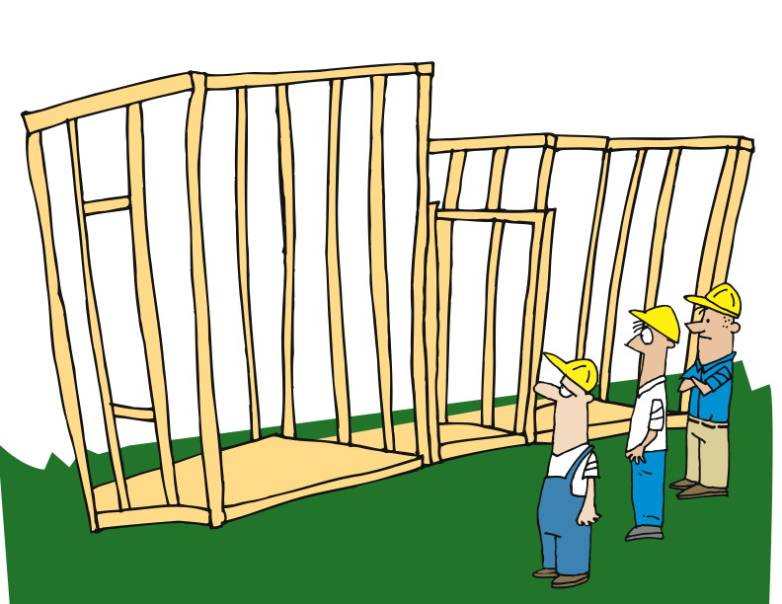
Check and Fail Early
Notes:
Continuous Integration incorporates short cycles to identify issues early
Failing fast, fail early does not mean we want to fail
It means find the failures as early as possible to reduce cost
A joke in chicago on election days is “Vote early, vote often”. Integrate early, Integrate often.
The big difference with Continuous Integration is that we incorporate short cycles so that we can identify issues as early as possible.
In the Agile world, we talk about failing fast or failing early. This is sometimes misunderstood to mean that we are hoping to fail or planning to fail. That’s not so. What we are doing is acknowledging that failures will occur, and hoping to find them as soon as possible to minimize their total impact.
One of the most important tools in this approach is continuous integration.
At regular – and short – intervals, we bring everything together to see if what we’ve done so far all works well together.

Slide 50
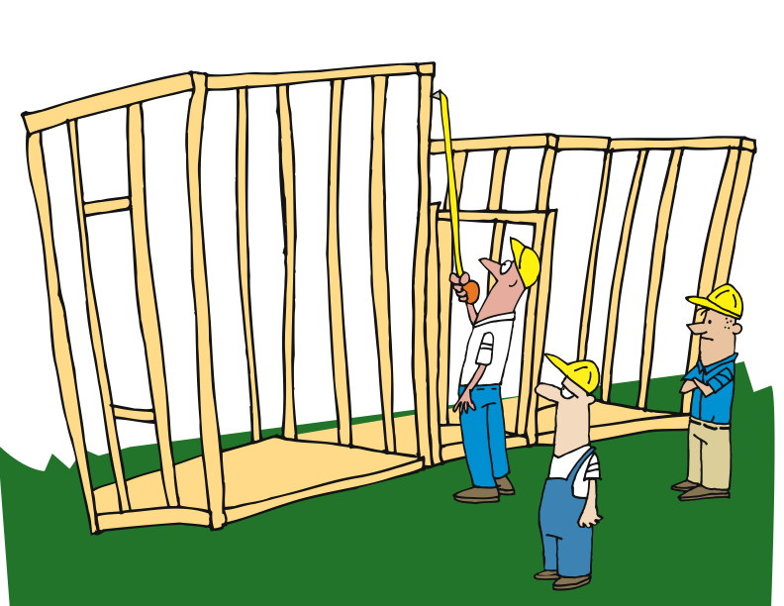
Check
Notes:
Check and test regularly
CI processes may run every time someone checks in code
Full suite of tests run against the code
Remember TDD
Builds take too long. There are ways to address this.
Rather than waiting until we’re all done – or at least, we THINK we’re all done – we do our checking and testing and integrating on a regular basis.
In fact, depending on your circumstances, it’s pretty common for development teams to set up the continuous integration process to run every time someone checks in code. That means that a full suite of tests is run against the code every time someone makes a change.
Don’t forget about our earlier discussion of Test-Driven Development. We embrace the practice of writing tests for all of our development, so that test base grows every time code is checked in too.
Of course, at some point, it starts to take too long to run ALL the tests every time someone checks in code. There are solutions to this, which are beyond the scope of this module. Suffice it to say that others have run into this problem, and have taken steps to address them. In fact, Cruise, the continuous integration server from ThoughtWorks Studios, was specifically designed to address this from day one.

Slide 51
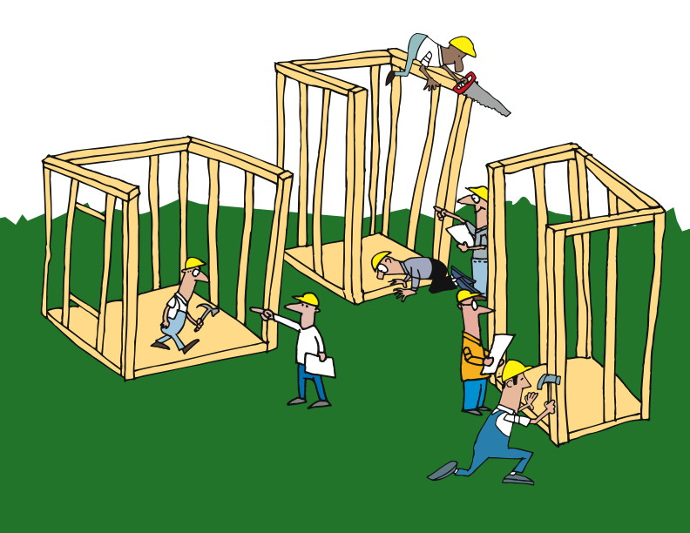
Adapt / Do
Notes:
Plan, Do, Check, Act continuously
------------------------------------------------------------------------------------------------
By embracing continuous integration – compiling, linking, loading, testing, and deploying – on an ongoing basis, we have a much better chance of failing early and finding and fixing problems when the cost is at its lowest.
As we follow the PDCA (remember that that stands for Plan, Do, Check, Act) cycle, we are continuously finding and fixing problems, and responding to situations close to when they occur.

Slide 52
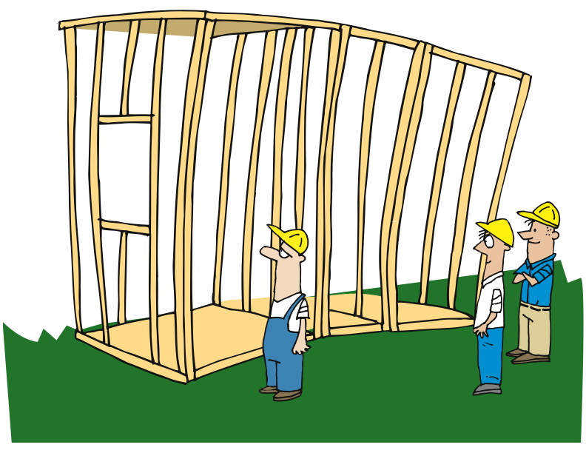
Notes:
That cycle of rapid and timely feedback allows us to make changes and corrections early.

Slide 53
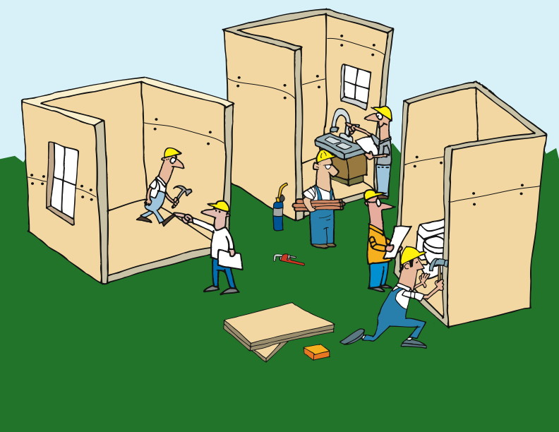
Notes:
And because we do this on an ongoing basis…

Slide 54
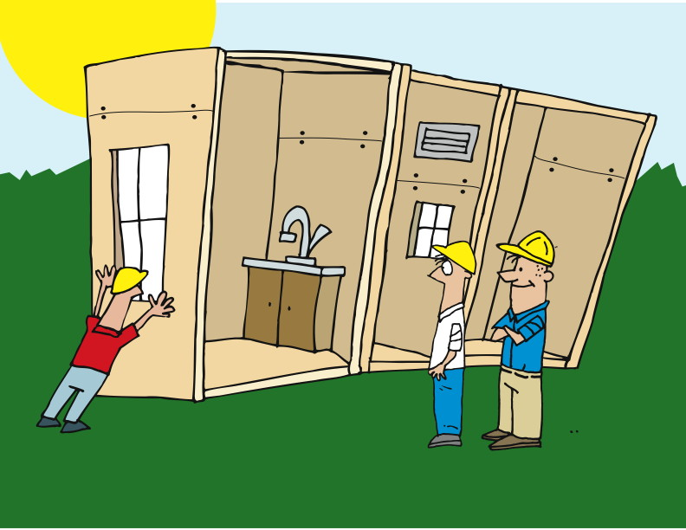
Notes:
Working software at the end of each iteration.
We are checking for and finding problems much earlier, so that we are fulfilling one of the principles of Agile: working software at the end of each iteration. Rather than waiting months or years to be able to see and use the software under development, we are using continuous integration to make sure that all of our parts work, and that they work together.

Slide 55
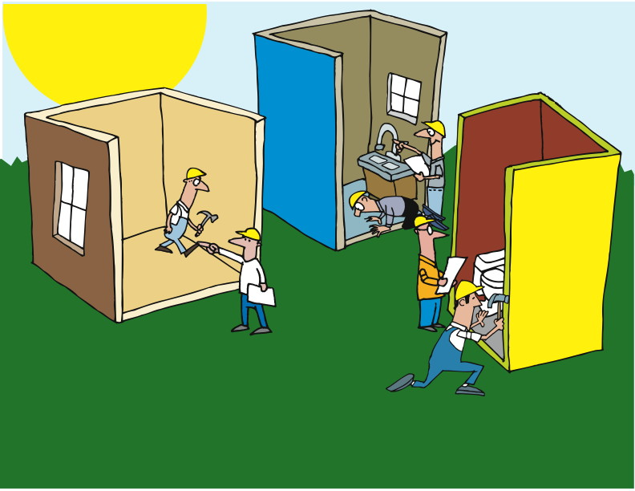
Notes:
And by using a combination of regression tests and deployment testing, we get away from the common developer assertion that “it works on MY box!”

Slide 56
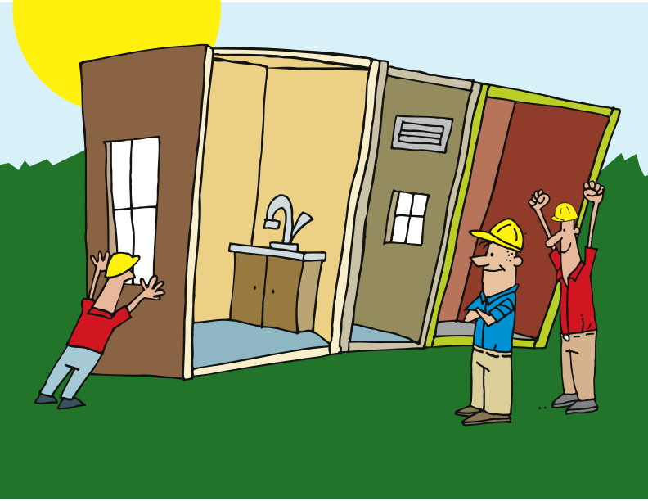
Notes:
Since we’re testing on a build server – or maybe on multiple servers – and testing the deployment as we go, we reduce the number of surprises we receive at the end.

Slide 57
Questions?
Notes:
What we’ve done……
Seen how best practices address traditional project challenges
Learned the process
Met the team

